Slide 1
BREWBEAN SALES
PERFORMANCE ANALYSIS
Client Stakeholder Presentation
Coffee Sales & Business Insights
Project context
Client: BrewBean Café Pvt. Ltd.
Stakeholder: Regional Operations Manager
Role: Business Analyst | Project ID: BA-2026-003
BrewBean Café Pvt. Ltd. | Sales & Operations | 1
Notes:
Opening — 30 to 40 seconds
“Good morning. This presentation covers the BrewBean Coffee Shop Sales Analytics project. The objective is to use the sales data to understand revenue trends, outlet performance, customer behaviour and product profitability, and then convert those findings into practical business recommendations. I will first show the overall performance, then revenue and operations, promotions and customer behaviour, and finally the actions I recommend.”

Slide 2
1. Executive Snapshot
The dashboard gives a quick view of sales scale, profitability and customer experience.
TOTAL SALES
293,688.48
Overall revenue
TRANSACTIONS
800
Recorded transactions
TOTAL PROFIT
175,869.48
Overall profit
AVERAGE RATING
3.99
Customer rating
What stands out
Sales are spread across multiple outlets, with visible differences in outlet revenue and profit.
Monthly revenue is fairly steady from January to June, with March the strongest visible month and June the weakest.
Customer experience is close to a 4.0 average rating, leaving room for improvement.
Management takeaway
Protect the strongest revenue periods and promotions.
Plan staffing around the busiest trading hours.
Investigate lower-performing outlets and product categories.
Use payment and promotion patterns to improve conversion.
BrewBean Café Pvt. Ltd. | Sales & Operations | 2
Notes:
Executive snapshot — about 45 seconds
“From the dashboard, total sales are 293,688.48 across 800 transactions, with total profit of 175,869.48. The average customer rating is 3.99. So the business is generating healthy sales and profit, but there is still an opportunity to improve customer satisfaction. Monthly sales are relatively stable, with March looking strongest and June weakest in the visible period. The main management opportunity is to understand why some outlets, promotions and time periods perform better than others.”

Slide 3
2. Revenue & Outlet Performance
Revenue and profit vary by outlet, creating an opportunity to benchmark stores.
Revenue by outlet
Profit by outlet
Insight
Outlet revenue is broadly clustered, but the chart shows a clear highest-performing outlet and a few lower performers.
Profit follows a similar pattern, so outlet-level operational practices are likely important to profitability.
Recommended action: benchmark the strongest outlet against weaker outlets on staffing, product mix, promotions and operating practices.
BrewBean Café Pvt. Ltd. | Sales & Operations | 3
Notes:
Revenue and outlet performance — about 50 seconds
“Here I am comparing revenue and profit by outlet. The outlets are not identical in performance: one outlet is visibly ahead on revenue, while a few are lower. The profit chart shows a similar spread. The business should therefore not use one standard approach for every store. I recommend taking the strongest outlet as a benchmark and comparing staffing, product mix, promotions and daily operations with the weaker outlets.”

Slide 4
3. Sales Trend & Category Mix
Monthly movement is stable overall, while category revenue shows clear differences.
Sales by month
Category by revenue
Key insight
March is the strongest visible month; June is the weakest, indicating a softening toward the end of the displayed period.
Category revenue is uneven, so product/category-level focus can help protect revenue.
Recommended action: investigate the June dip and replicate the product mix that performs strongly in peak months.
BrewBean Café Pvt. Ltd. | Sales & Operations | 4
Notes:
Sales trend and category mix — about 45 seconds
“The monthly chart shows a fairly consistent sales pattern from January to June. March is the highest visible month and June is the lowest. The category chart also shows that revenue is not evenly distributed across categories. So I would investigate what changed in June — for example product demand or promotional activity — and use the strongest category mix from better-performing months as a benchmark.”

Slide 5
4. Customer Behaviour & Operations
Payment preference and time-of-day demand can directly support operational planning.
Sales by payment method
Busiest hours of the day
Operational insight
UPI is the strongest visible payment method by revenue; digital payments are important to the business.
Transaction activity peaks around 08:00–10:00 and again around 18:00–20:00.
Recommended action: schedule more staff and faster order preparation during these peak windows.
BrewBean Café Pvt. Ltd. | Sales & Operations | 5
Notes:
Customer behaviour and operations — about 50 seconds
“The payment chart shows UPI as the strongest visible payment method by revenue, which means digital payment convenience should be maintained. The busiest-hours chart shows two clear demand windows: around 8 to 10 in the morning and again around 6 to 8 in the evening. This is operationally important. BrewBean can reduce congestion by placing more staff and preparing fast-moving items before these peak periods.”

Slide 6
5. Promotions, Products & Customer Satisfaction
The strongest promotional and product signals can be used to increase sales while protecting experience.
Revenue by promotion
Top 10 product by rating
Product quantity
Key findings
Summer is the strongest visible promotion; Weekly and Student promotions are also among the stronger performers.
Top-rated products sit around the 4.1–4.4 range, while the overall average rating is 3.99.
The quantity chart shows a few products with noticeably higher demand; these should receive priority for availability during peak hours.
BrewBean Café Pvt. Ltd. | Sales & Operations | 6
Notes:
Promotions, products and satisfaction — about 55 seconds
“The promotion chart shows Summer as the strongest visible campaign, with Weekly and Student also performing strongly. On customer ratings, the top products are around the 4.1 to 4.4 range, while the overall average is 3.99. The quantity chart shows that some products sell much more than others. Therefore, BrewBean should keep high-demand products available during peak hours and use the best-performing promotions selectively rather than discounting everything.”

Slide 7
6. Business Questions: What the Dashboard Answers
Evidence-based answers aligned to the client brief.
Highest revenue/profit outlets
Outlet charts show clear performance differences; the leading outlet should be benchmarked against lower performers.
Highest customer segment revenue
Not directly proven in the current dashboard: Membership is available as a slicer, but revenue by membership is not shown.
Top-selling products
Quantity chart shows a small group of higher-volume products; keep these products well stocked.
Preferred payment method
UPI is the strongest visible payment method by revenue.
Busiest hours
08:00–10:00 and 18:00–20:00 are the main visible peaks.
Highest-rated products
Top 10 products are approximately 4.1–4.4; exact names are truncated in the screenshot.
Best promotions
Summer is the strongest visible campaign; Weekly and Student are also strong.
Operational improvement
Lower-performing outlets and peak-hour congestion are the clearest improvement areas.
BrewBean Café Pvt. Ltd. | Sales & Operations | 7
Notes:
Business questions — about 55 seconds
“This slide maps the dashboard directly to the client’s business questions. We can answer the outlet performance, product demand, busiest hours, promotions, payment method and product rating questions from the current visuals. One point needs to be stated carefully: the current dashboard has Membership as a slicer, but it does not show revenue by membership segment, so I would not claim which customer segment contributes the most revenue without an additional analysis.”

Slide 8
7. Recommendations & Expected Business Actions
Priorities are tied directly to the patterns visible in the analysis.
1
Peak-hour staffing
Add/shift staff and pre-prepare high-volume items for 08:00–10:00 and 18:00–20:00.
2
Promotion focus
Scale the strongest visible campaigns, especially Summer, and monitor ROI before extending discounts.
3
Outlet benchmarking
Compare lower-performing outlets with the strongest outlet on staffing, product mix, promotions and process.
4
Product availability
Protect stock availability for high-quantity products during peak periods.
5
Customer experience
Use the 3.99 average rating as a baseline and target improvement through service consistency and product quality.
Bottom line
Focus resources on peak hours, strong promotions, high-volume products and outlet-level improvement.
BrewBean Café Pvt. Ltd. | Sales & Operations | 8
Notes:
Recommendations — about 60 seconds
“My recommendations are fivefold. First, staff around the two peak windows and prepare fast-moving products in advance. Second, focus promotions on campaigns that visibly generate stronger revenue, especially Summer, while monitoring return on promotion. Third, benchmark weaker outlets against the strongest outlet. Fourth, protect stock availability for high-volume products. Fifth, improve customer experience from the current 3.99 rating baseline. These recommendations are directly linked to the patterns shown in the dashboard.”

Slide 9
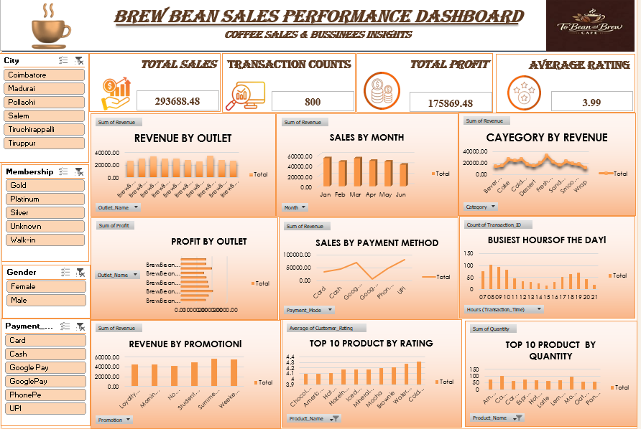
8. Dashboard Overview

Slide 10
Closing Message
From descriptive analysis to practical action.
“The opportunity is not only to sell more — it is to sell smarter.”
Final stakeholder message
Use data to align staffing with demand.
Concentrate promotions on proven performers.
Benchmark outlet performance and protect high-demand products.
Improve the customer experience while growing revenue.
Thank you — Questions & Discussion
BrewBean Café Pvt. Ltd. | Sales & Operations | 9
Notes:
Closing — 20 to 30 seconds
“To conclude, the dashboard gives BrewBean a practical basis for improving both sales and operations. The immediate priorities are peak-hour capacity, stronger promotions, product availability, outlet benchmarking and customer experience. Thank you. I’m happy to take questions.”

